Slide 1
Week 9- Message Authentication Codes
Source: Raj Jain Washington University in Saint Louishttps://www.cse.wustl.edu/~jain/cse571-11/ftp/l_12mac.pdf

Slide 2

Message Authentication Codes
Was this message altered?
Did he really send this?

Slide 3

Overview
Message Authentication
MACS based on Hash Functions: HMAC
MACs based on Block Ciphers: DAA and CMAC
Authenticated Encryption: CCM
Pseudorandom Number Generation Using Hash Functions
These slides are based partly on Lawrie Brown’s slides supplied with William Stallings’s book “Cryptography and Network Security: Principles and Practice,” 5th Ed, 2011.

Slide 4
Message Security Requirements
The following cases should be prevented:
Revelation: It means releasing the content of the message to someone who does not have an appropriate cryptographic key.
Analysis of Traffic: Determination of the pattern of traffic through the duration of connection and frequency of connections between different parties.
Deception: Adding out of context messages from a fraudulent source into a communication network. This will lead to mistrust between the parties communicating and may also cause loss of critical data.
Modification in the Content: Changing the content of a message. This includes inserting new information or deleting/changing the existing one.
Modification in the sequence: Changing the order of messages between parties. This includes insertion, deletion, and reordering of messages.
Modification in the Timings: This includes replay and delay of messages sent between different parties. This way session tracking is also disrupted.
Source Refusal: When the source denies being the originator of a message.
Destination refusal: When the receiver of the message denies the reception.
Message Authentication = Integrity + Source Authentication

Slide 5




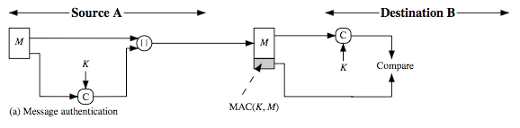
Public-Key Authentication and Secrecy
B’s Public Key
A’s Private_{Message} Key
A
B
A
B
Double public key encryption provides authentication and integrity. Double public key ⇒ Very compute intensive
Crypto checksum (MAC) is better. Based on a secret key and the message.
Can also encrypt with the same or different key.

Slide 6
MAC Properties
A MAC is a cryptographic checksum
MAC = C_{K}(M)
Condenses a variable-length message M using a secret key
To a fixed-sized result
Is a many-to-one function
Potentially many messages have same MAC (remember hash functions)
But finding these needs to be very difficult
Properties:
It is infeasible to find another message with the same MAC
MACs should be uniformly distributed
MAC should depend equally on all bits of the message
Notes:
MAC-based message verification requires both the sender and receiver to follow specific steps to ensure the message's credibility: The sender and receiver share a secret symmetric key. The sender runs a standard algorithm to create the MAC. As input, the algorithm takes the original message and the secret key.

Slide 7
Security of MACs
Brute-force attacks exploiting
Strong collision resistance hash have cost 2^{m/2}
MACs with known message-MAC pairs
Can either attack keyspace or MAC
128-bit hash looks vulnerable, 160-bits better

Slide 8
HMAC Design Objectives
HMAC is a general design. Can use any hash function
⇒ HMAC-MD5, HMAC-SHA-256
Uses hash functions without modifications
Keyed Hash ⇒ includes a key along with message
Allow for easy replace-ability of embedded hash function
Preserve original performance of hash function without significant degradation
Uses and handles keys in a simple way.
Has well understood cryptographic analysis of authentication mechanism strength

Slide 9
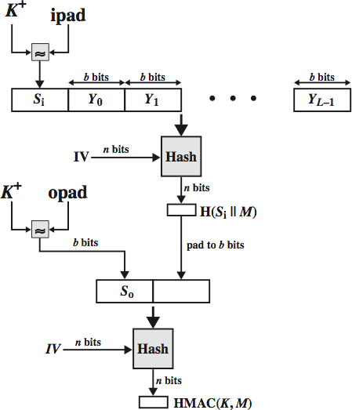
HMAC
RFC2104
Uses hash function on the message: HMAC_{K}(M) =
H[(K⁺⊕opad)||H[(K⁺⊕ipad)|| M)] ]
Where K⁺ = key padded to b-bits or hashed to b-bits if |k|>b
b = block size for the hash
opad, ipad are constants
ipad = 36^{b/8}, opad = 5C^{b/8}
Any hash function can be used
E.g., MD5, SHA-2, RIPEMD-160,
Whirlpool
Proved that security of HMAC relates to that of the underlying hash algorithm

Slide 10
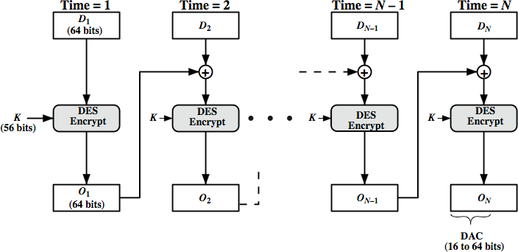
Using Symmetric Ciphers for MACs
Can use any block cipher chaining mode and use final block as a MAC
Data Authentication Algorithm (DAA) = DES-CBC
Using IV=0 and zero-pad of final block
For single block message X, T=MAC(K, X)
⇒T=MAC(K,X||(X⊕T))
Notes:
The DAC consists of either the entire block ON or the leftmost M bits of the block, with 16 <= M <= 64.

Slide 11
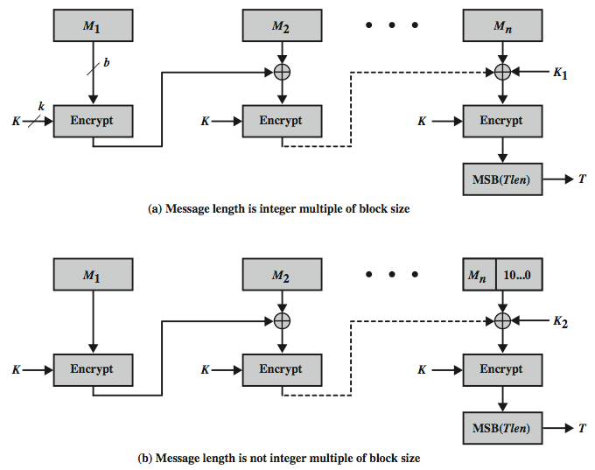
Cipher-based Message Authentication Code (CMAC)
CMAC is a block cipher-based algorithm that uses a secret key to generate a message authentication code (MAC) for a given message.
The algorithm works by dividing the input message into fixed-length blocks, each of which is processed by the block cipher in a special way.
The CMAC algorithm is based on the CBC-MAC (Cipher Block Chaining Message Authentication Code) technique, which uses the block cipher in CBC mode to generate a MAC for a given message.

Slide 12
Authenticated Encryption
Confidentiality+Integrity:
Hash-then-encrypt: E(K, (M || H(M))
MAC-then-encrypt: E(K₂, (M || MAC(K₁, M)) Used in SSL/TLS
Encrypt-then-MAC: (C=E(K₂, M), T=MAC(K₁, C)
Used in IPsec
Encrypt-and-MAC: (C=E(K₂, M), T=MAC(K₁, M)
Used in SSH
But security vulnerabilities with all these
NIST fixed these vulnerabilities with CCM and GCM

Slide 13
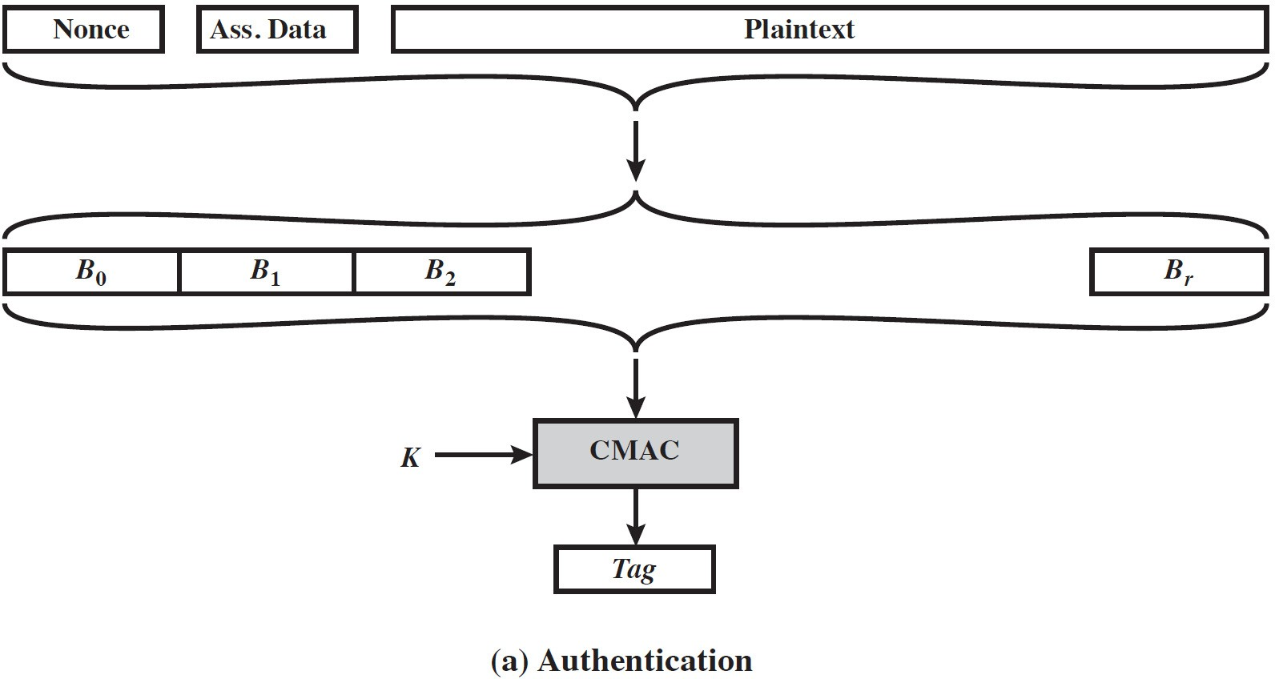
CCM
Counter with Cipher Block Chaining-MAC
NIST SP 800-38C for WiFi
Algorithmic ingredients
AES encryption algorithm
CTR mode of operation
CMAC authentication algorithm
Ctr₁
Ctr₂
Ctr_{m}
Ctr_{m+1}
K
E
K
E
…
K
E
K
E
P₁
⊕
P₂
⊕
P_{m}
⊕
Tag
⊕
Single key for both encryption & MAC
2 passes over plaintext:MAC+E
C₁
C₂
C_{m}
^{C}m+1
Associate data = headers in clear

Slide 14
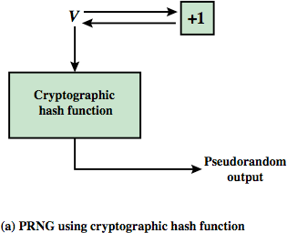
PRNG using a Hash Function
SP800-90 and ISO18031
Take seed V
Repeatedly add 1
Hash V
Use n-bits of hash as random value
Secure if good hash used

Slide 15



Summary
Message authentication = Integrity + Source Authentication (with or without encryption)
Double public key encryption can be used but complex
⇒ Hash with a secret key
HMAC is a general procedure usable with any hash function
⇒ HMAC-MD5, HMAC-AES
Data Authentication Algorithm (DAA) was found insecure
⇒ Fixed by CMAC using keys derived from a single key
Authenticated Encryption:
CCM = CMAC + Counter mode
Pseudorandom Number Generation (PRNG) using Hash Functions

